Slide 1


Slide 2


Slide 3
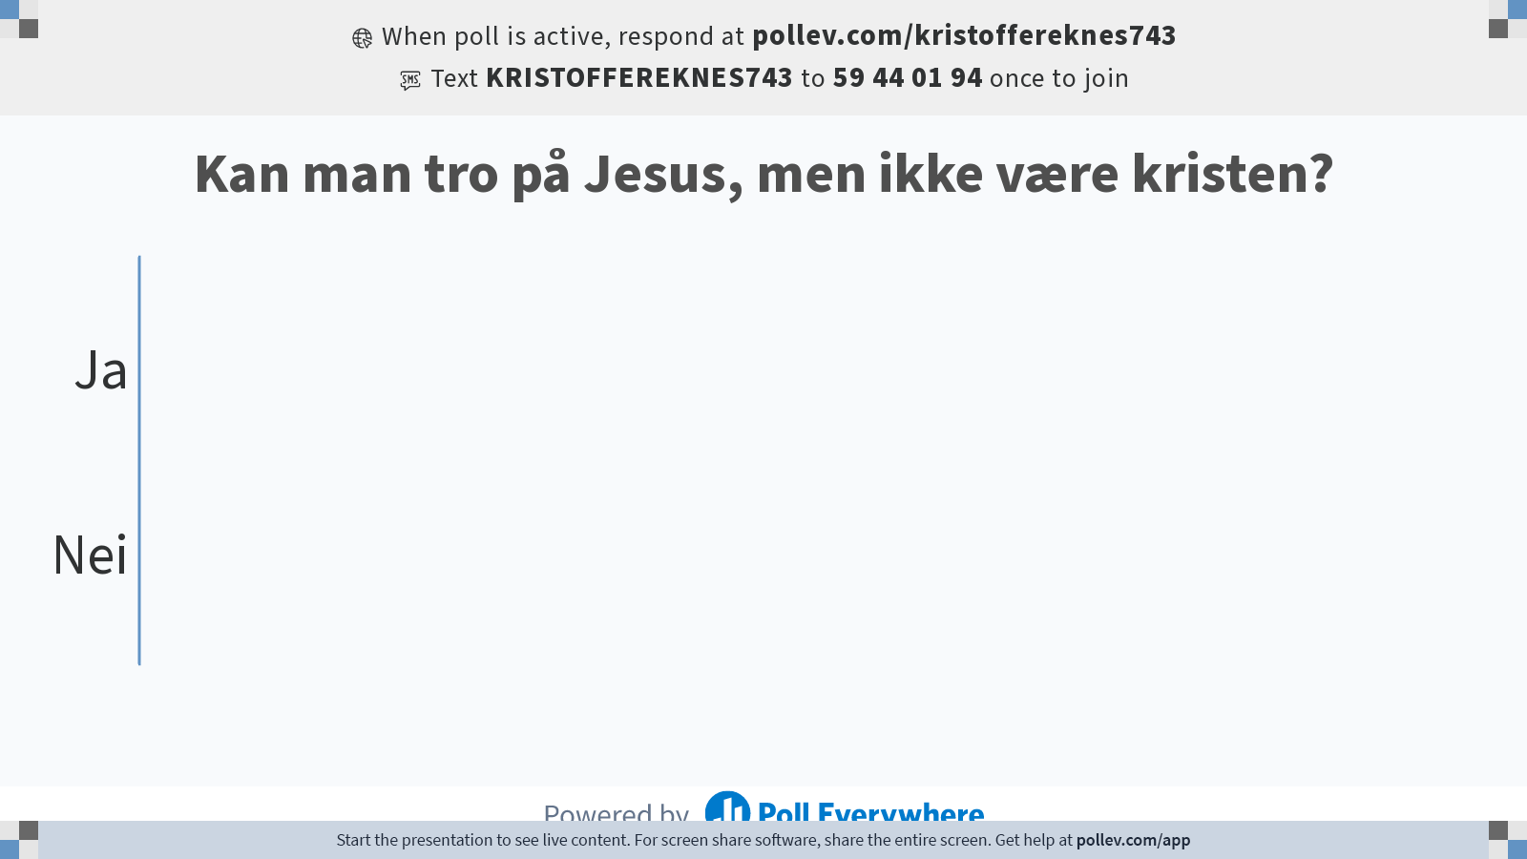
Notes:
Do not modify the notes in this section to avoid tampering with the Poll Everywhere activity.
More info at polleverywhere.com/support
Kan man tro på Jesus, men ikke være kristen?
https://www.polleverywhere.com/multiple_choice_polls/TWjzGnBrd47Toe3SboJjV?state=opened&flow=Default&onscreen=persist

Slide 4


Slide 5
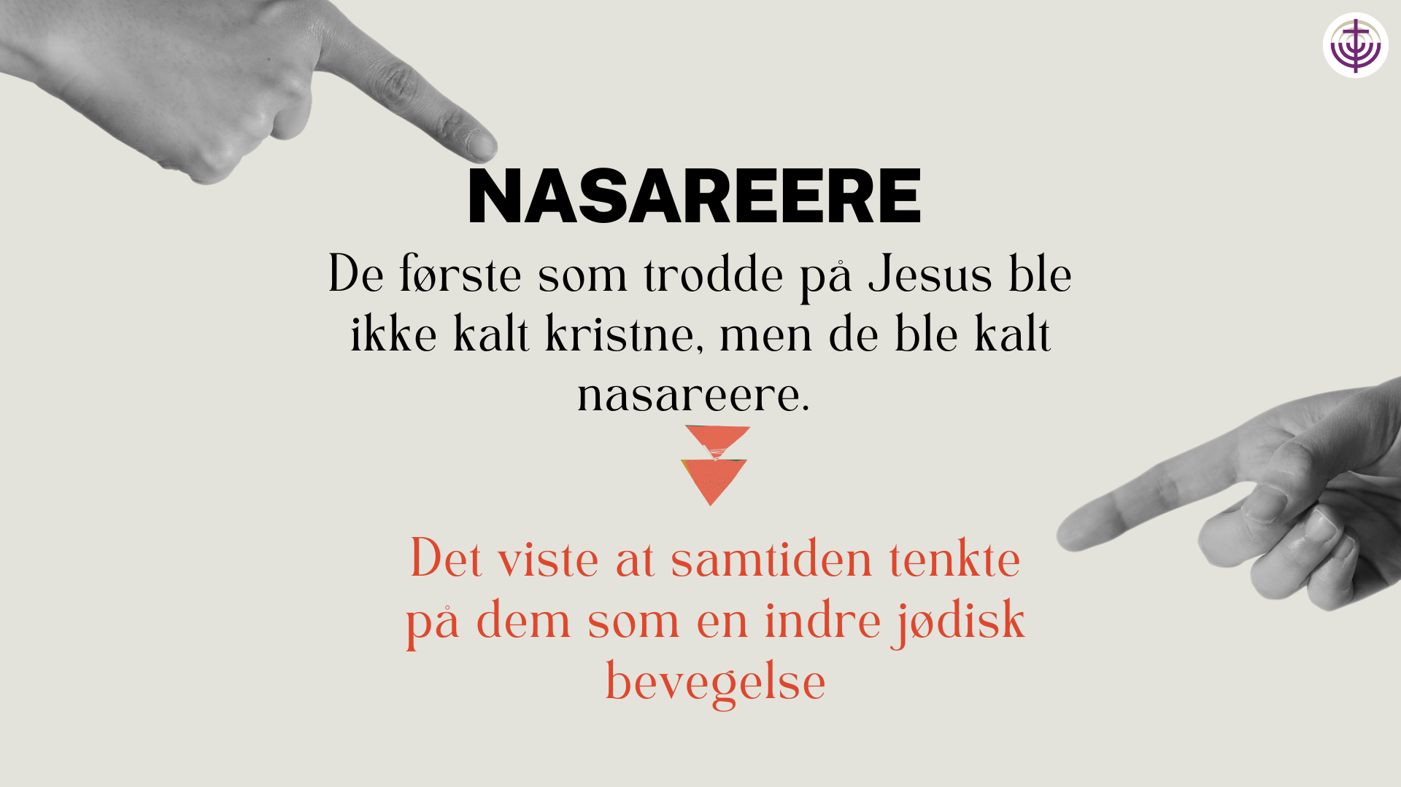

Slide 6
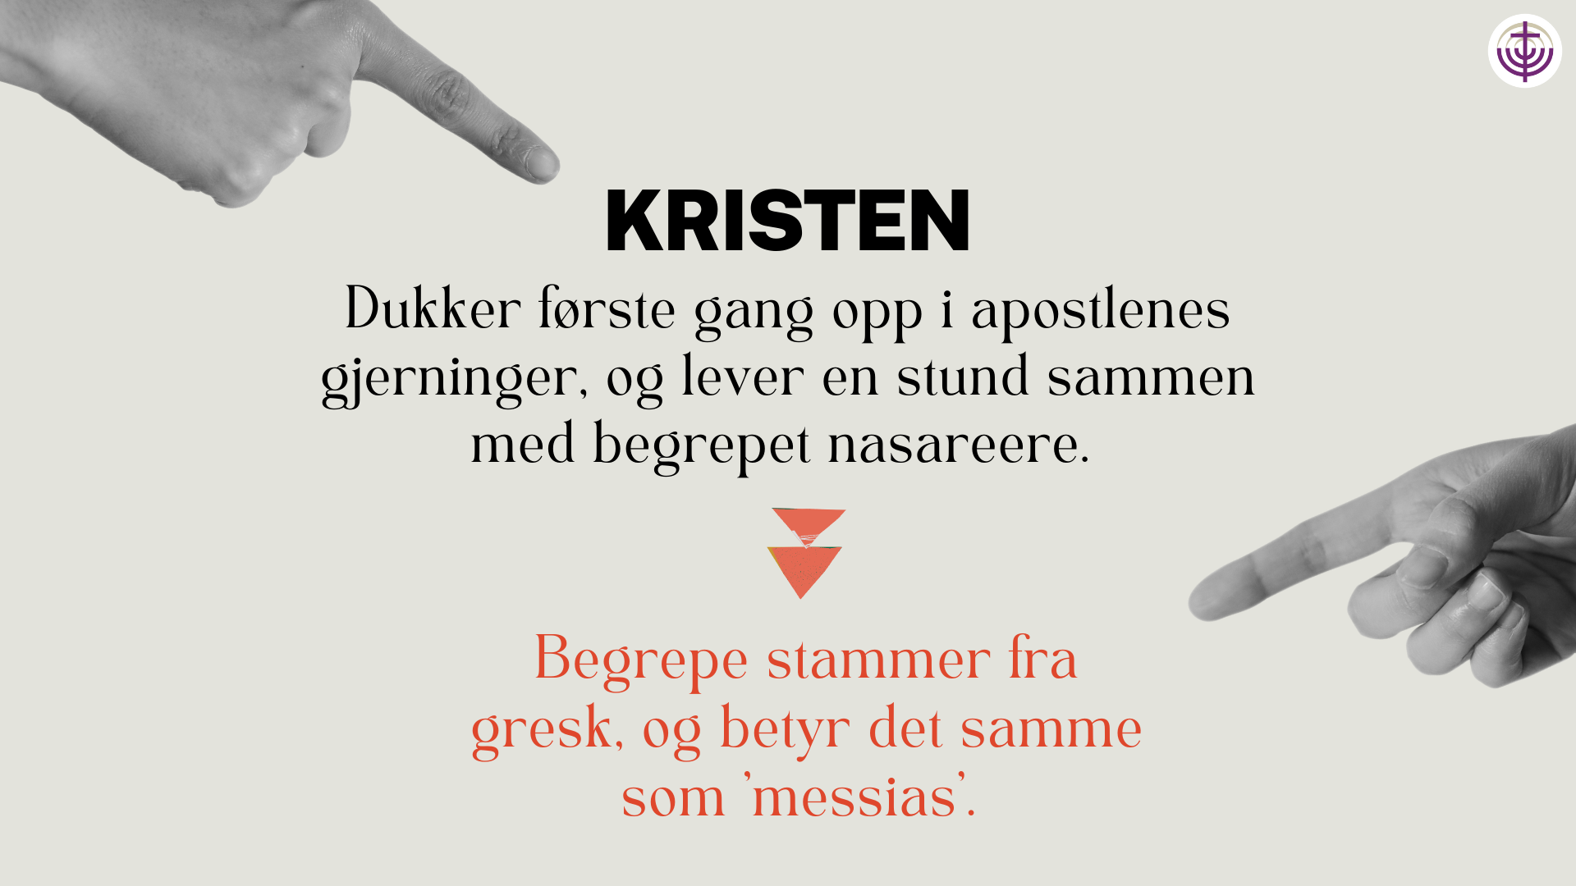

Slide 7
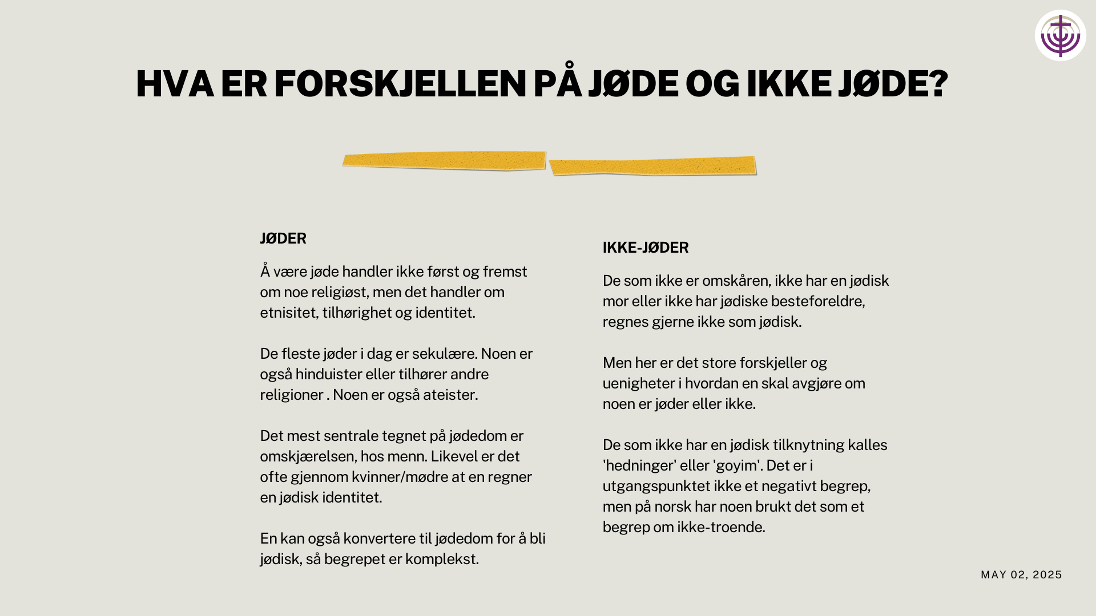

Slide 8
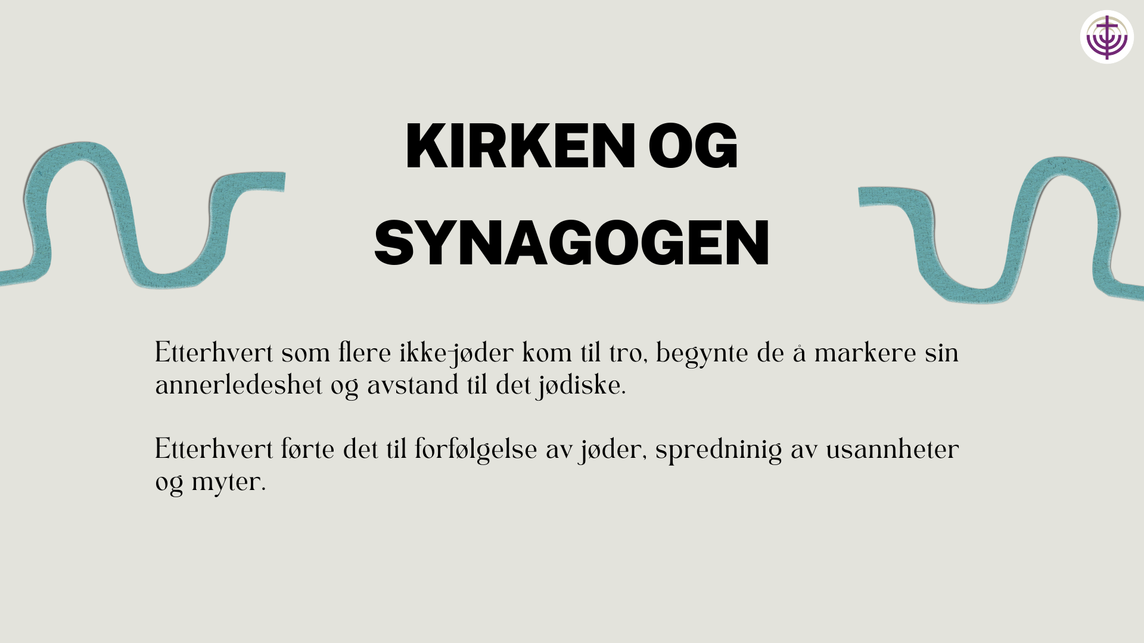

Slide 9


Slide 10


Slide 11
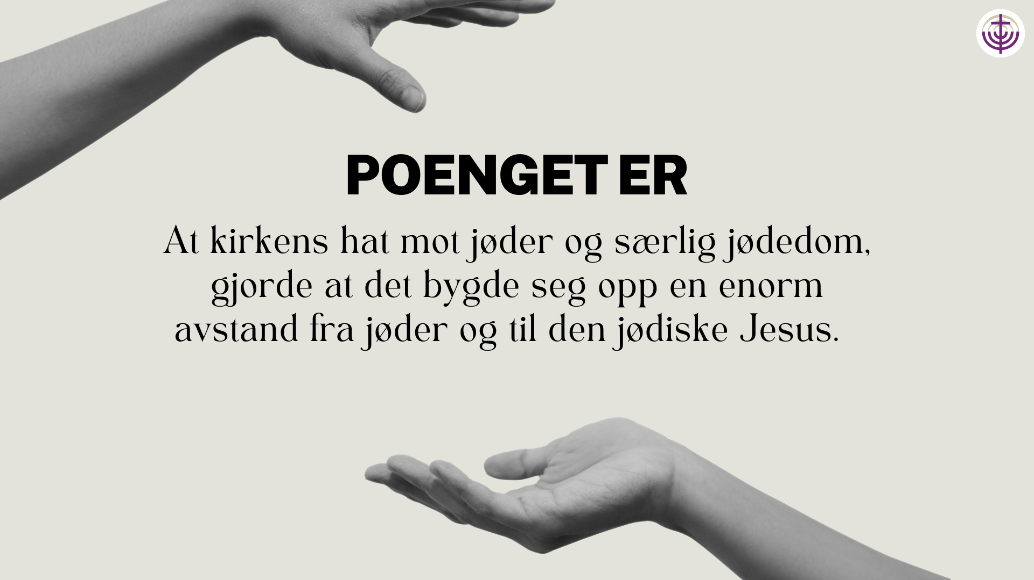

Slide 12


Slide 13


Slide 14


Slide 15


Slide 16
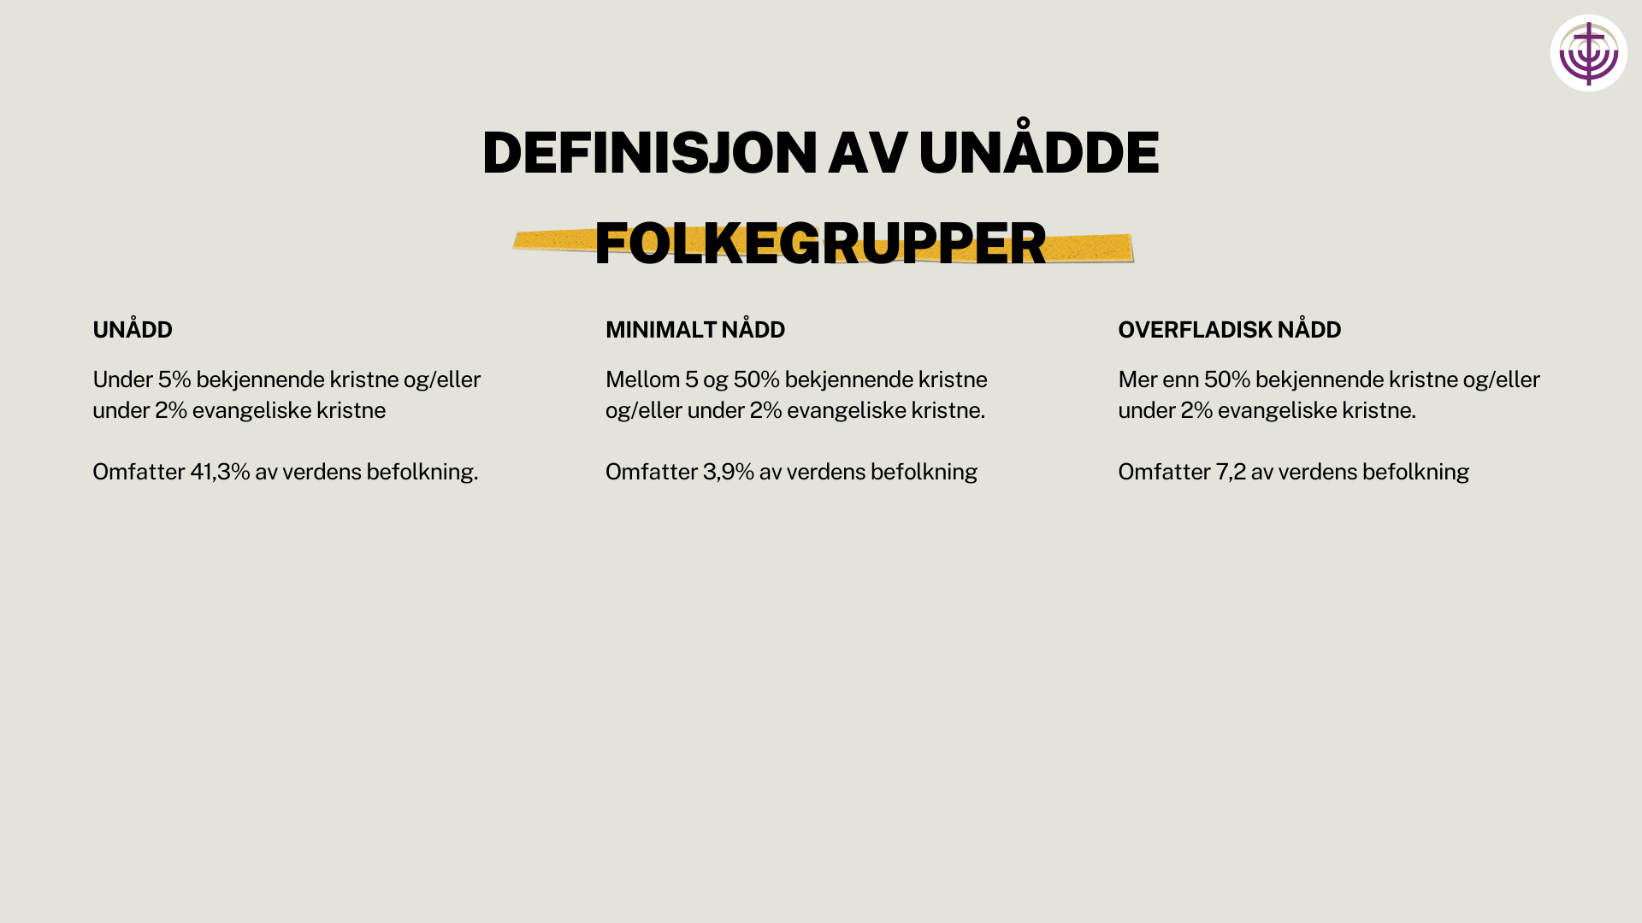

Slide 17
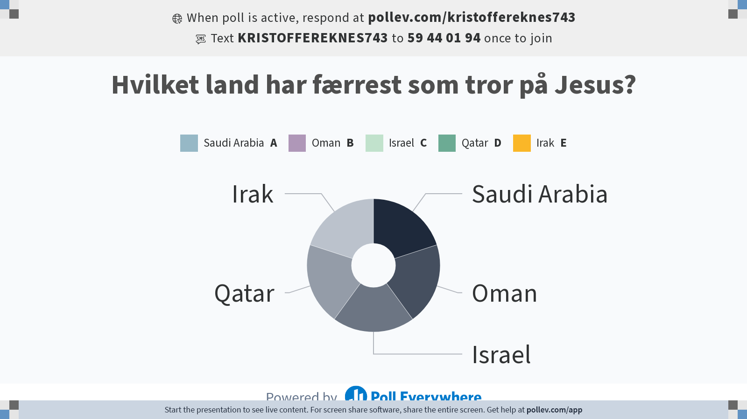
Notes:
Do not modify the notes in this section to avoid tampering with the Poll Everywhere activity.
More info at polleverywhere.com/support
Hvilket land har færrest som tror på Jesus?
https://www.polleverywhere.com/multiple_choice_polls/nXPAdI05pMpUugVfM9vDe?state=opened&flow=Default&onscreen=persist

Slide 18


Slide 19


Slide 20
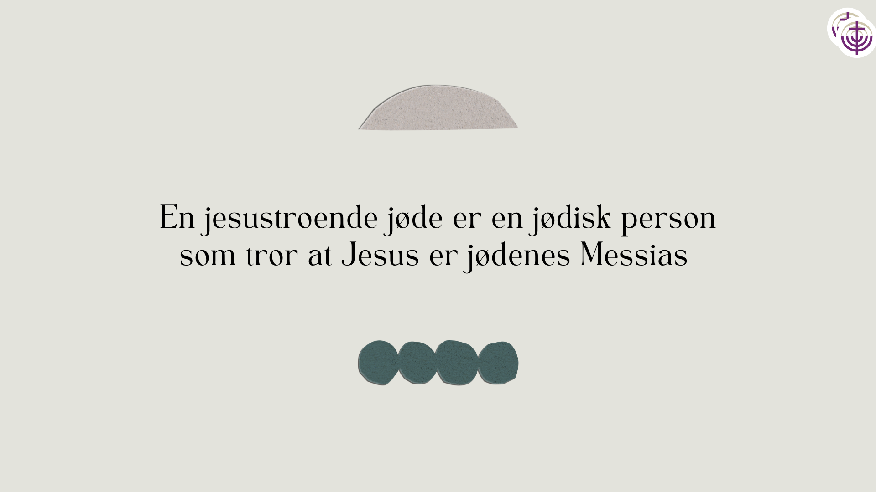

Slide 21
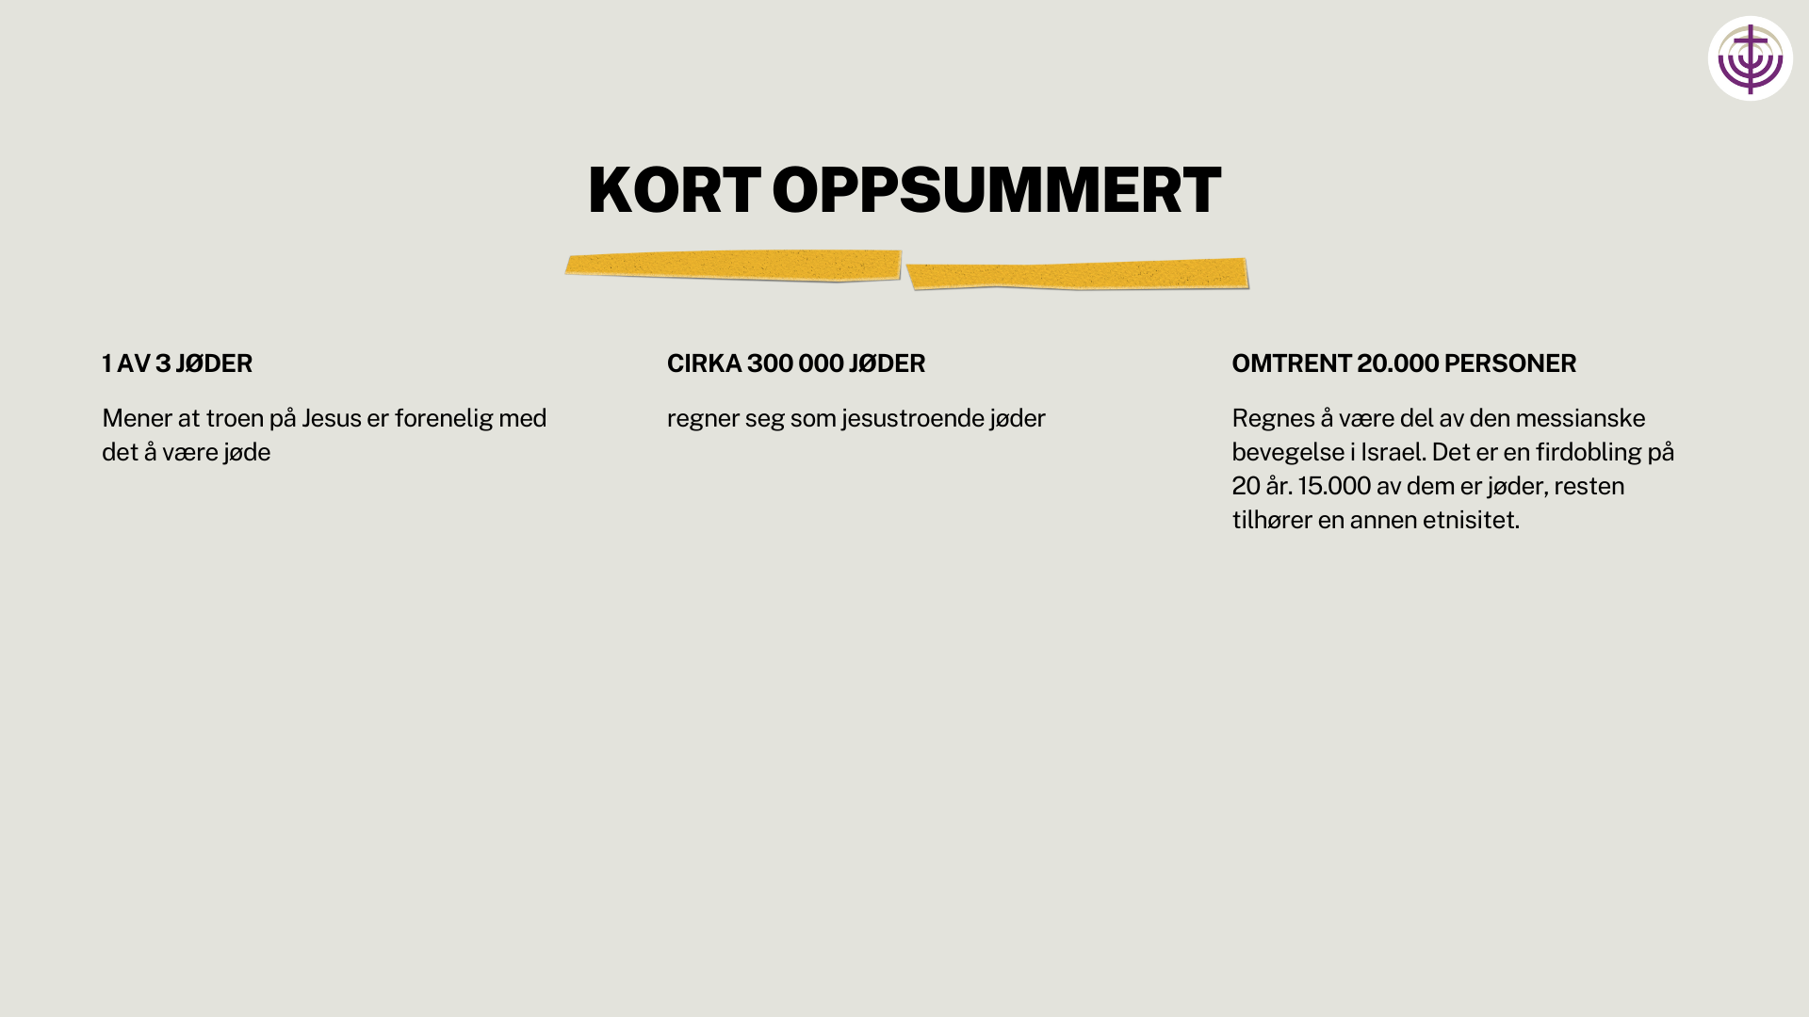

Slide 22


Slide 23
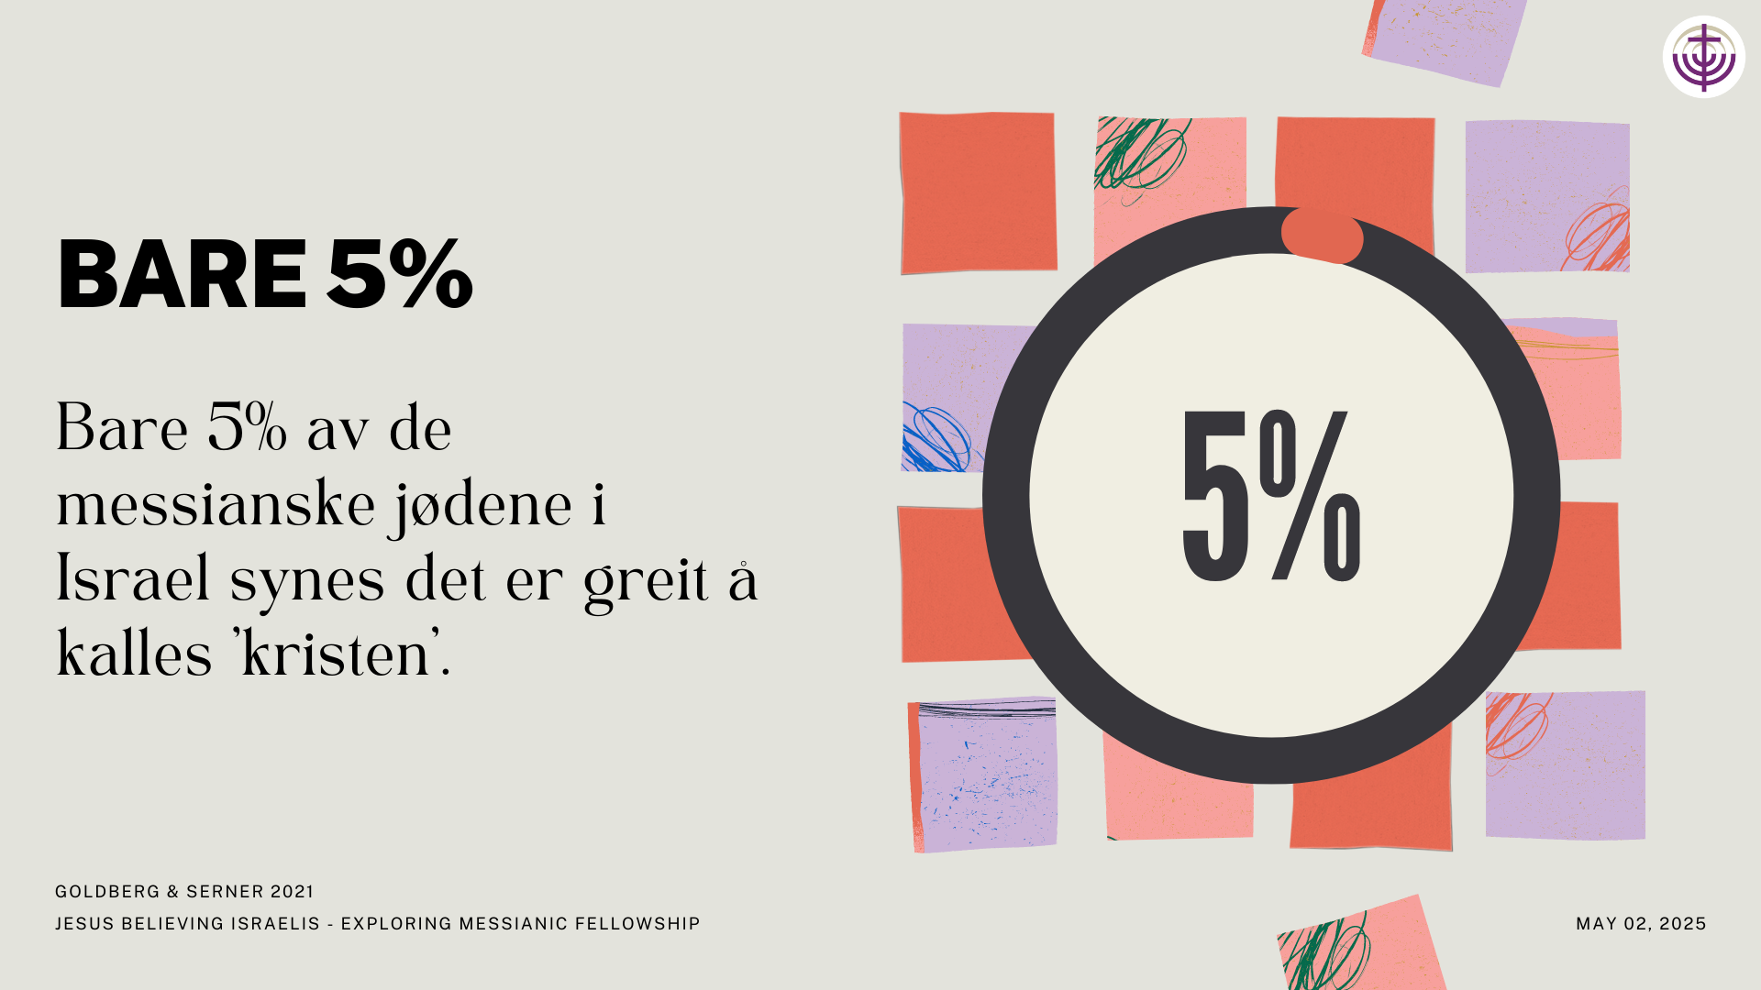

Slide 24
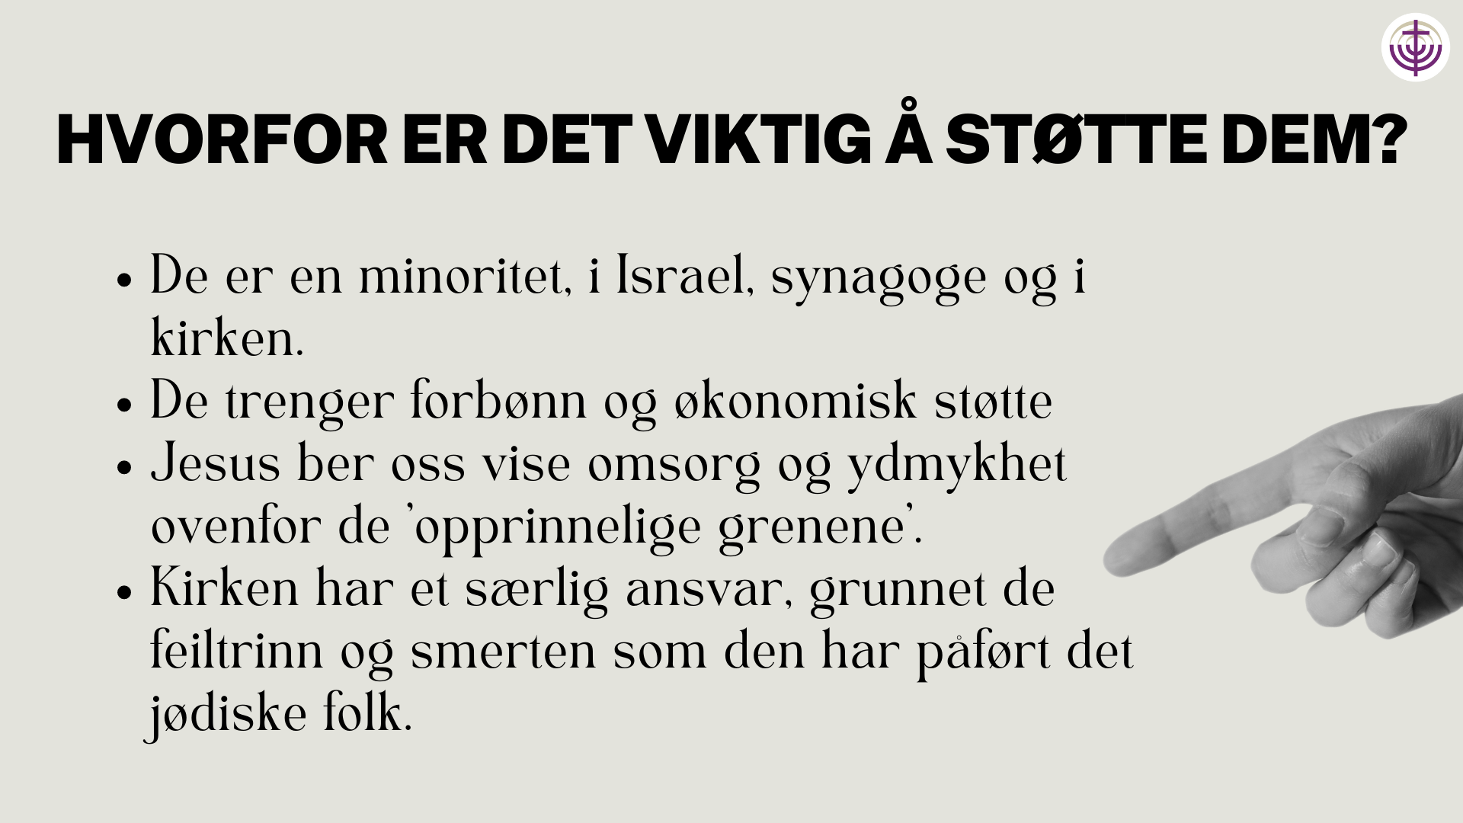

Slide 25


Slide 26
