Slide 1
The Theology of Reconciliation
Optional or Obligated?

Slide 2
reconciliation rɛk(ə)nsɪlɪˈeɪʃ(ə)n
1. the restoration of friendly relations.
"his reconciliation with your uncle“
2. the action of making one view or belief compatible with another.
"any possibility of reconciliation between such clearly opposed positions“
3.the action of making financial accounts consistent; harmonization.
"the reconciliation process should be consistent with the business strategy“
4. A socio-political concept

Slide 3
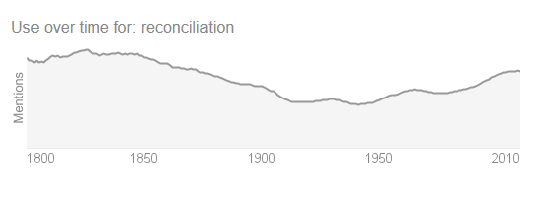

Slide 4

What is Reconciliation in Christian Theology and tradition?
Something more then a friendly relationship?
A Sacrament?
A Fruit?
A Gift?
A Process?
Something Contextual or Something Universal?
Something we may choose to do, or Something we are called to do?

Slide 5

God is passionate about reconciliation
Ambassadors of Christ (2. Cor. 5:13 – 21).
Peace for those far and near (Ephesians 2:17).
Blessed are the peacemakers (Matthew 5:9).
Reconciliation rituals (Deuteronomy 21:1-9).
Unity (John 17:1-26).
Live at peace with everyone (Rom 12:18-21)
Strongly intertwined with the Reconciliation with God.

Slide 6
“[…] reconciliation indicates, in essence, a renewal of all human relationships starting with the new relationship of the Christian God”.
Vorster, J.M. (2018): “The Doctrine of Reconciliation: Its meaning and implications for social life”, p.3
Notes:
The concentric circles of reconciliation

Slide 7
ENEMIES
PEOPLE
All Inclusive – no prioritized order
CHURCH
GOD

Slide 8
“When the faithful confess in the Holy Communion that they are one in Christ as His body, they simultaneously pick up the yoke of being a therapeutic community”
Vorster, J.M. (2018): “The Doctrine of Reconciliation: Its meaning and implications for social life”, p.5
Notes:
The church is calling all people to reconcile with God and to become part of a new community, the Body of Christ. The priestly community, should act as a therapeutic one that nurtures reconciliation amidst broken relationship – being a beacon to all humans. That is a common task for all believers.

Slide 9

One Body, but…
If the reconciliation among humans are intertwined to our reconciliation with God, may it then be optional?
Is it just words or do we need to act?

Slide 10
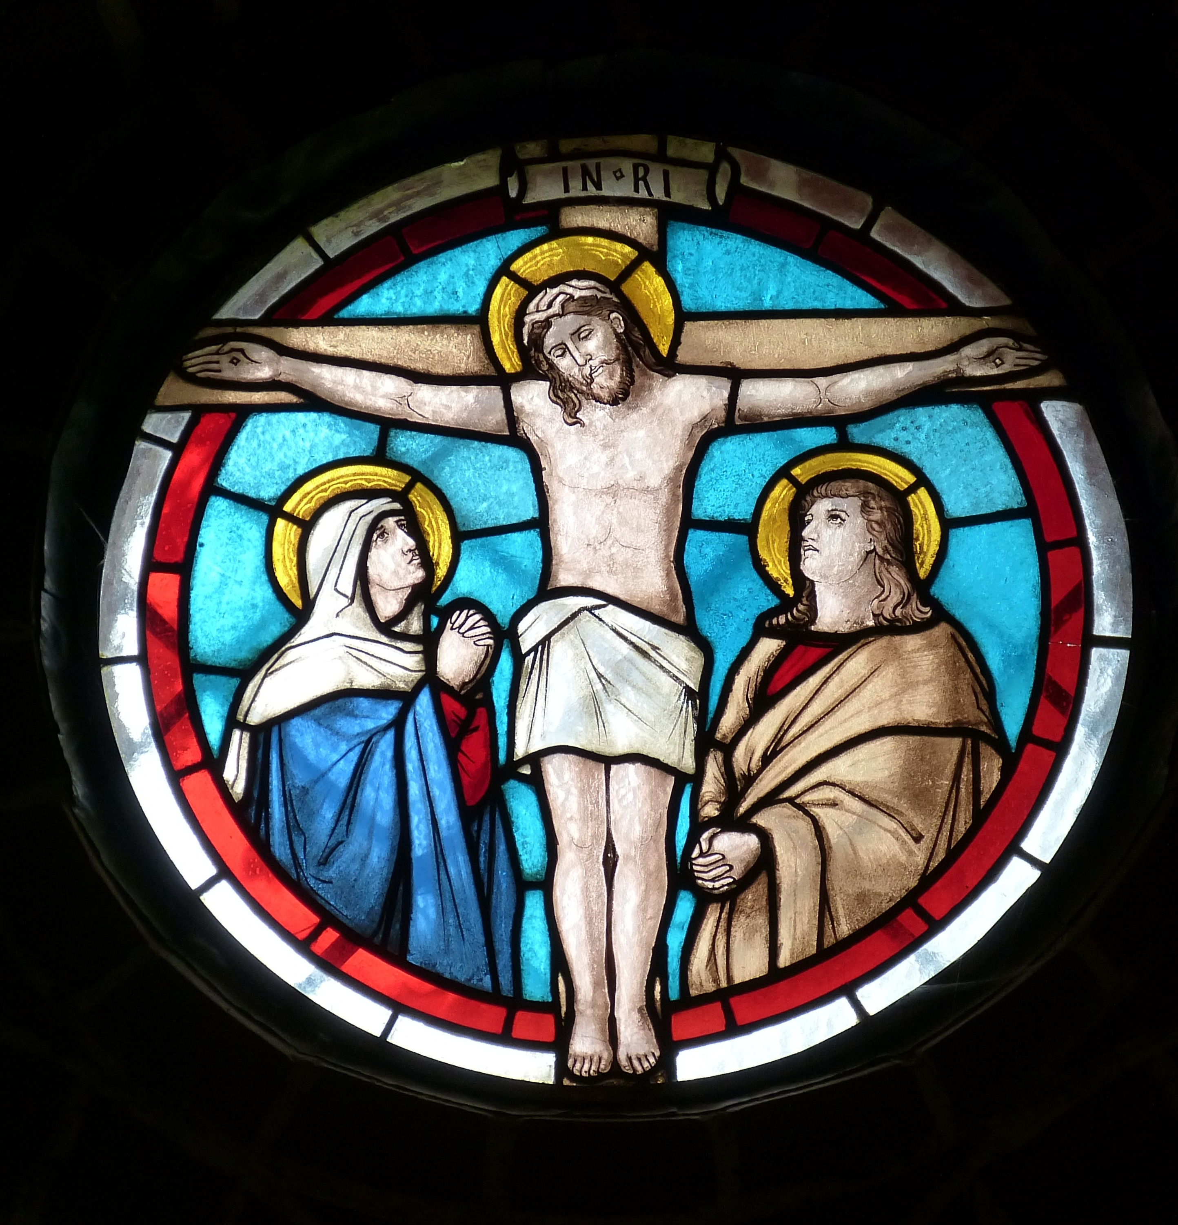
For us:
It does not seem optional, but something that is a natural consequence for all Christians.
Does it need to be Socio-Political?
- No, but sometimes Yes.
- We cannot isolate ourselves or others from the body of the Messiah.

Slide 11
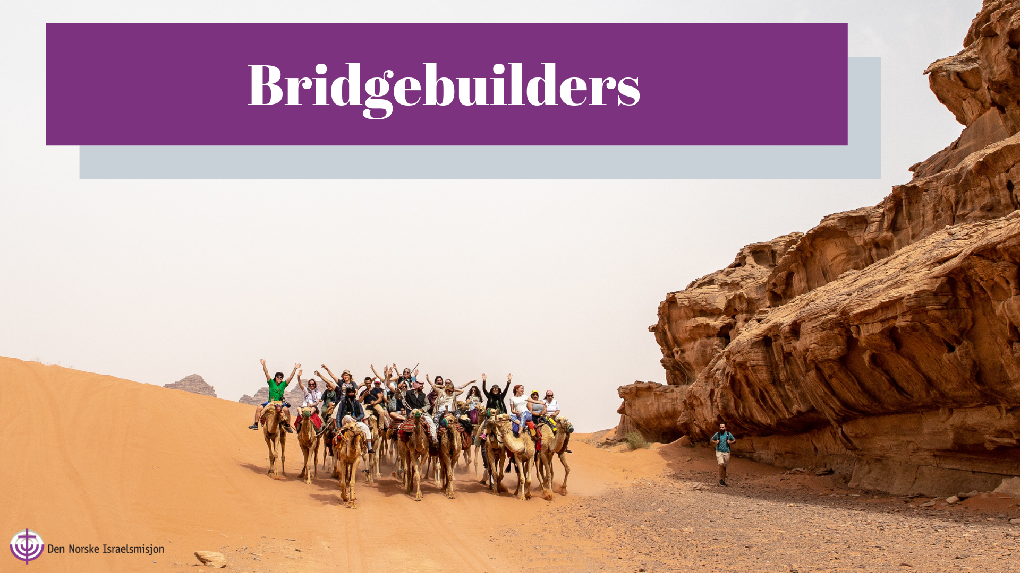

Slide 12
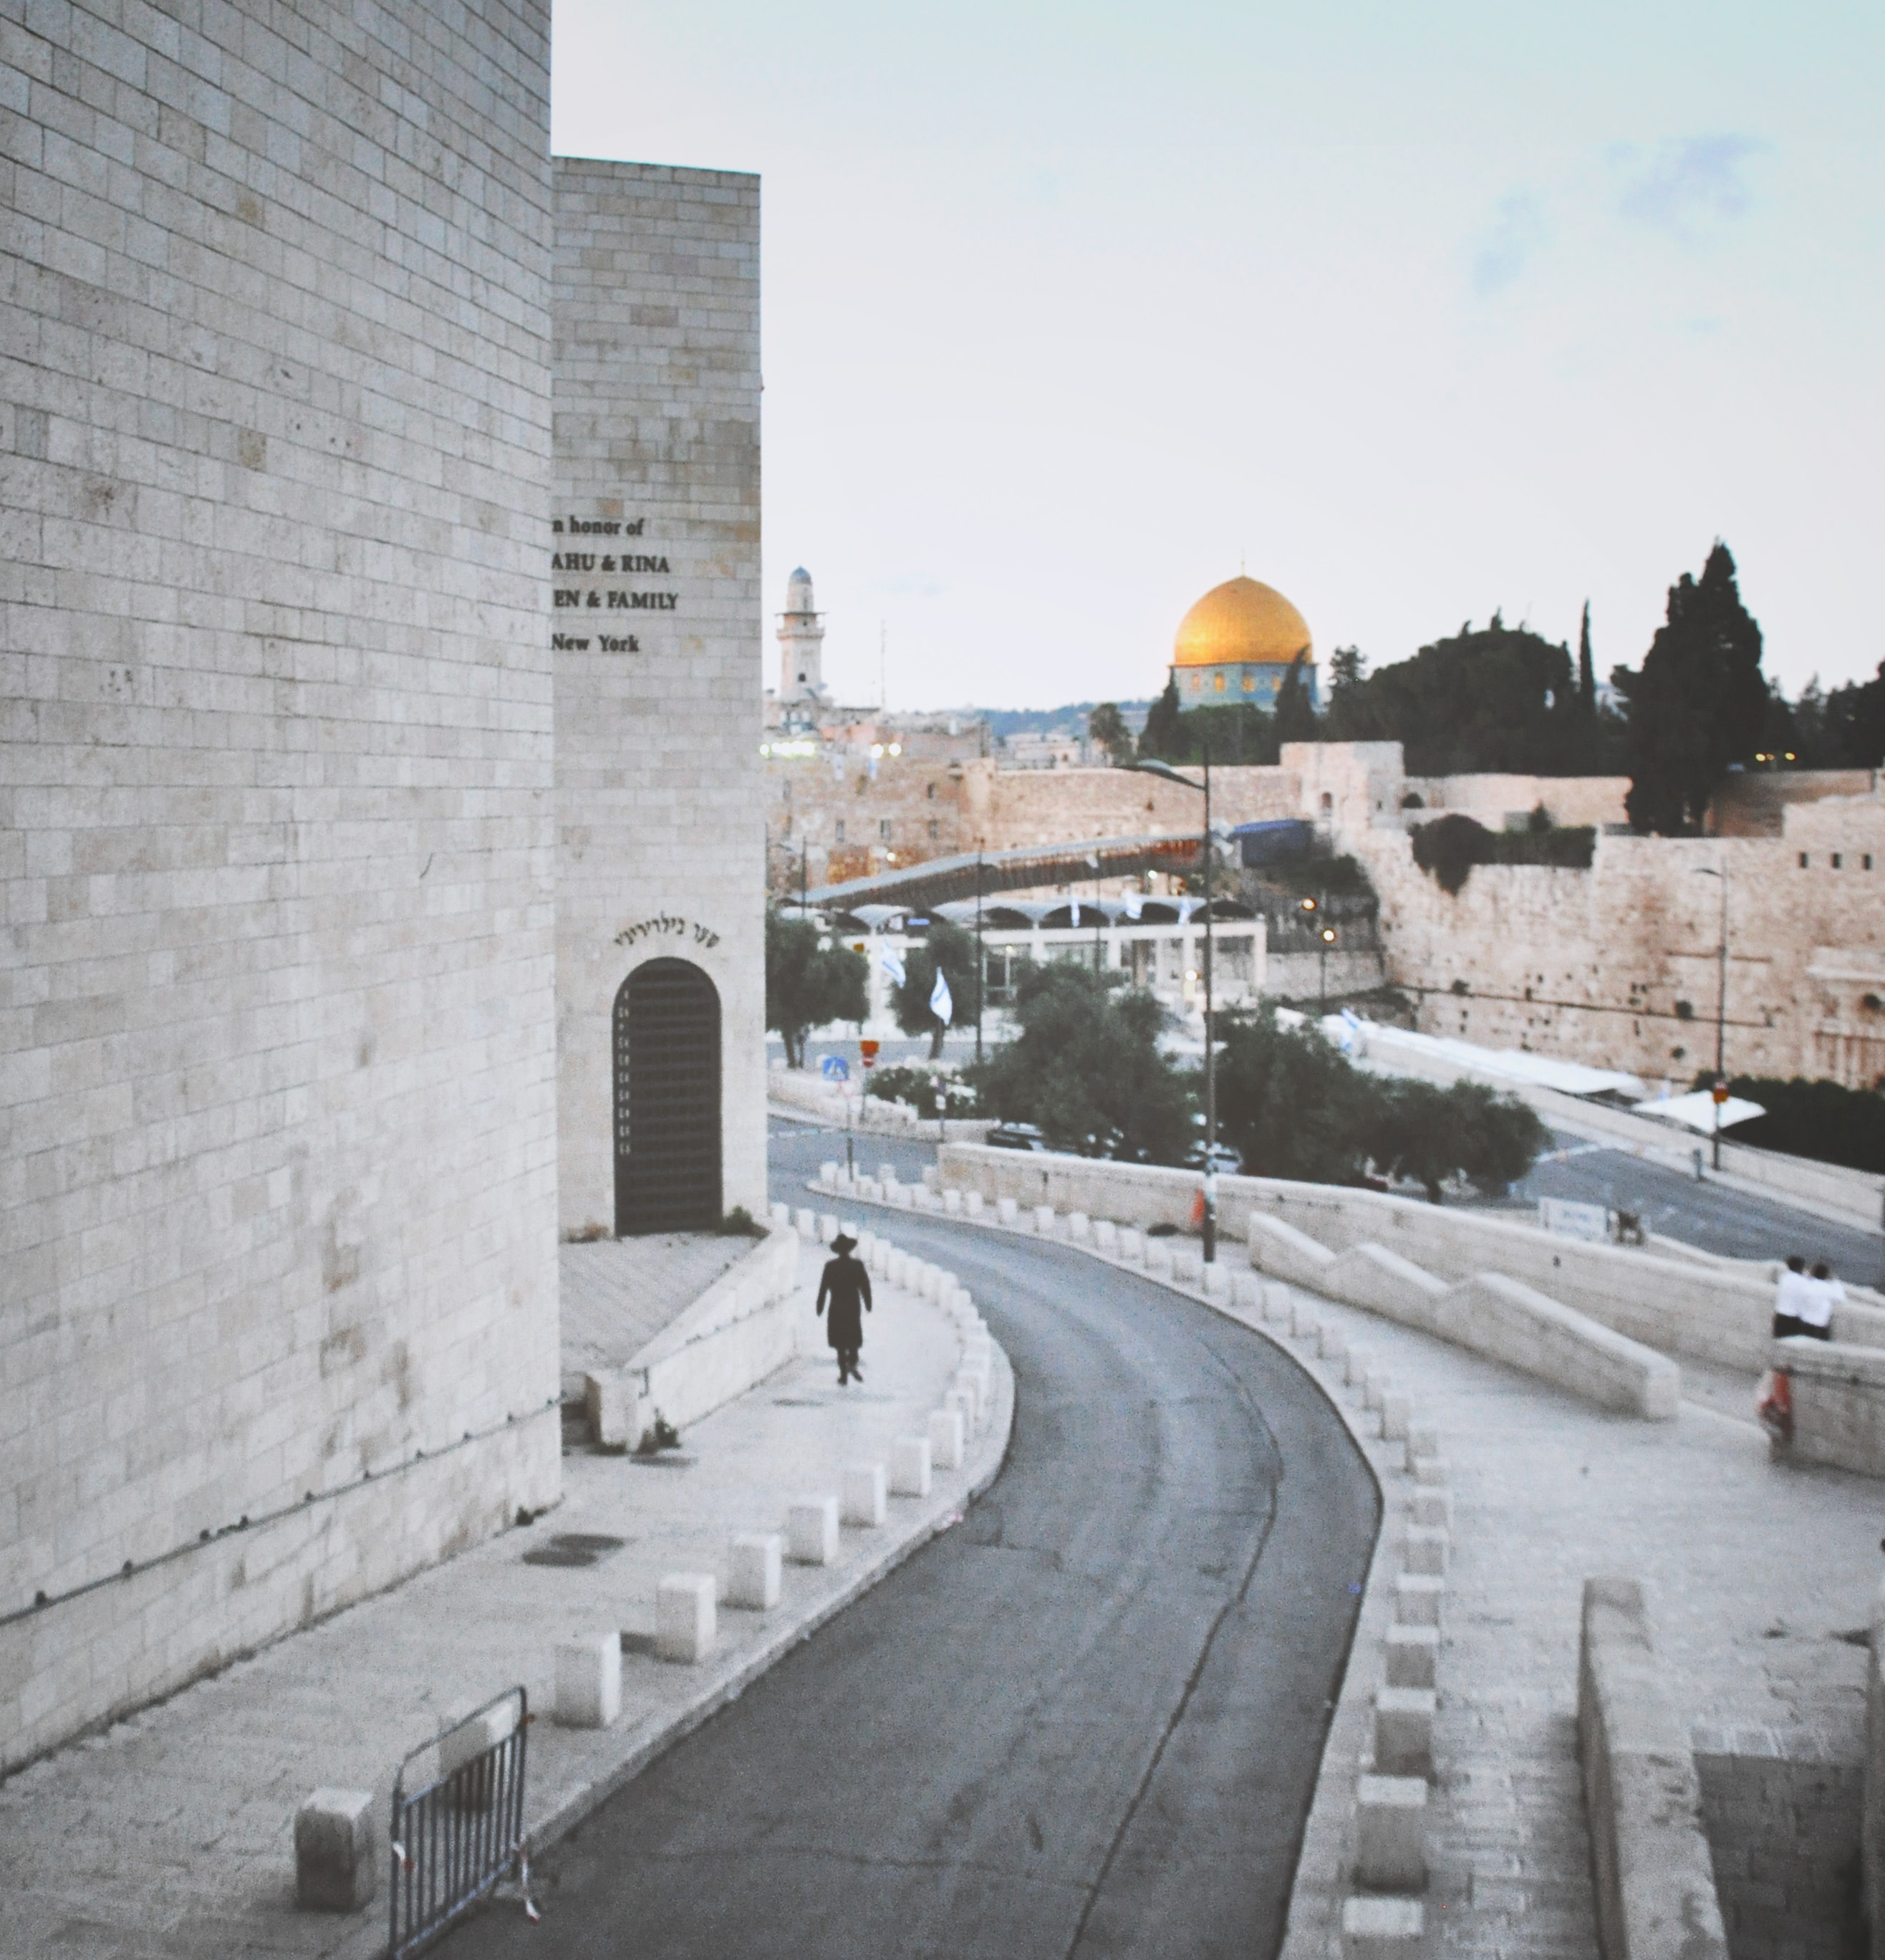
Other examples
Daughters of Jesus
Ebenezerhome
Machaseh

Slide 13
Story 1:
Before:
“I have never met a jew, but I hate them”.
After:
“I have discovered that not every Jew is the same. I have gotten good friends among them […] Especially a Jew called David. I consider Him my brother”.

Slide 14
Story 2:
“Why are you, Palestinians and Israeli Jews, walking together and laughing!?”
The individual became so interested that he wanted to learn more about Jesus. He got his first New Testament that day.

Slide 15
Bibliography
Vorster, J.M. (2018): “The Doctrine of Reconciliation: Its meaning and implications for social life”
Kok, J. (2012): “A Theology of Reconciliation in Contexts of Conflict and Change”
Kok, J. (2012): “Mission and Ethics in 1 Corinthians: Reconciliation, corporate solidarity and other-regard as missionary strategy in Paul”.
Oppenshaw, D.L., Nel, M. & Louw, L. (2018): “Conflict resolution and reconciliation within congregations”.
Messenger, J. (ed. 2004): “Mission in Context: Transformation, Reconciliation, Empowerment”.
Kleppe, J. & Langmoen, J.A. (2010): “Brobyggere mot alle odds” (Nor).
Musalaha (2017): “Theology and Reconciliation in Israel/Palestine”

