Slide 1

Is there a Great Commission?
An examination of the objections towards the understanding of the Great Commission

Slide 2

Agenda:
Is there a Great Commission?
  The not so Great Commission
  A Great Commission, but only for those present
  A Great Commission, but not from Jesus
  WHY MISSION?
  The general benefits
  The need of the Gospel

Slide 3
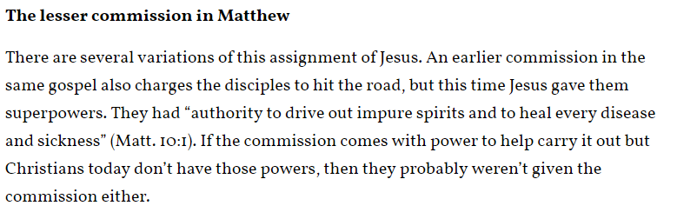
Is there a Great Commission?
Source: “The Great Commision and How it Doesn’t apply to you”,
http://www.patheos.com/blogs/crossexamined/2015/02/the-great-commission-and-how-it-doesnt-apply-to-you-jesus/

Slide 4
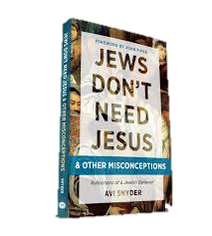
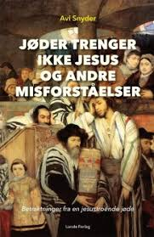
Is there a Great Commission?
“’I have given my word that I will have nothing to do with missionary activities, 'he said. Then he took out a folder, laid it on the bed, and showed me with solemn pride the document he’d signed, pledging silence about Jesus”.
Source: Snyder, Avi (2017): “Jews don’t need Jesus – and other misconceptions”, p.21

Slide 5
The objections
The academic objections (Theology and Humanist)
  The not so great commission
  A Great Commission, but only for those present
  A Great Commission, but not from Jesus
The historical uses of the passages (Crusades, holocaust, etc)
  Brainwashing
  Colonizing/Imperialism
  The abuse of divinity

Slide 6
How to take apart an Argument
Assertion
Relevance argument (counter or pro)
Argument

Slide 7
The Not so Great Commission
Assertion: The message, dubbed The Great Commission, is not more noteworthy than other message of Jesus.
Argument: Jesus said many things.
Relevance: There is no indication in the passage that this message is more important then others.
Relevance: Jesus was God, all he says is important.

Slide 8
THE Counter arguments
The context argument: Answering doubt by proclamation.
The High-Stake situation argument
The following events
Mentioned several places – marks a new era for the disciples (Mark 16:15-21, Acts 1:8, Matthew 28:16-20, John 20:21-23)

Slide 9
A Great Commission, but… (I)
Assertion: We should not be doing mission
Argument: The Great Commission was only intended for those present.
Relevance: There is no mention in the passage that the message was intended for anyone else than the disciples
Relevance: If it was not intended for us, we should not do mission

Slide 10
THE Counter arguments
No mention, no restriction
“I am with you(?) to the end of age” (v.20)
Paul and Matthias
Making new disciples

Slide 11
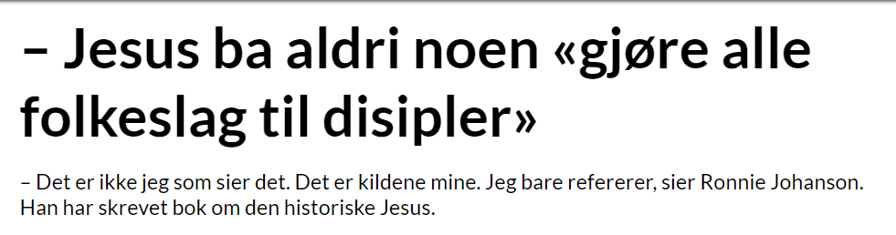

A Great Commission, but… (II)
Jesus never told anyone to “make people from all nations to disciples”
- It is not I who say this. It is my sources. I am only referring them, says Ronnie Johansson. He has written a book about the historical person Jesus
Source: Fritanke.no, http://fritanke.no/nyheter/jesus-ba-aldri-noen-gjore-alle-folkeslag-til-disipler/19.10764

Slide 12
A Great Commission, but… (II)
Assertion: The Great Commission is not a quote, but a later addition by the author.
Argument: Jesus operated exclusively in a Jewish context
Relevance: If Jesus operate exclusively in a Jewish context, he would not have asked his followers to evangelize among gentiles.

Slide 13
Were we Agree
Jesus did not want to start a new religion
Jesus operated in a Jewish context

Slide 14
THE Counter arguments
Jesus was claiming to be the Jewish Messiah – of course he did not want to start a new religion.
The Old Testament tells about a Jewish Messiah, that is also for the Gentiles.
Jesus lived in a Jewish Society
Jesus also met Gentiles.
The chronology of the Gospels (sources)

Slide 15
Conclusion?
“A Jewish Messiah would of course be operating amongst the Jewish people, but the Jewish Messiah would also know the Scriptures (OT) and what it says about the Gentiles. Furthermore, Jesus met Gentiles and revealed himself for them. He had to be the Jewish Messiah in order to also be the Christ of the Gentiles” Ergo, the fact that he operated mostly within a Jewish community, does not prove or imply that the Great Commission was a later addition by the author of Matthew, Mark or Acts”.

Slide 16

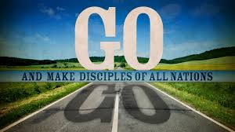
Where does that lead us?

Slide 17
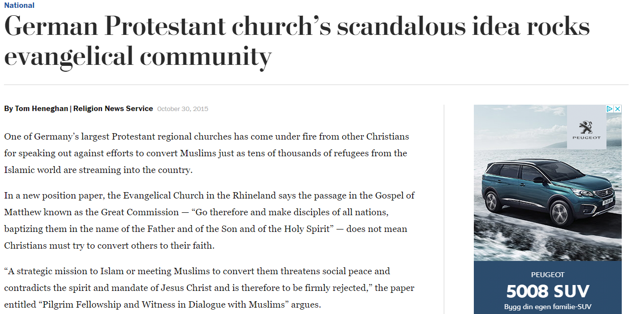
Why does It matter?

Slide 18
“Always be prepared to give an answer to everyone who asks you to give the reason for the hope that you have.
1.Peter, 3.15-17

Slide 19
Why Mission?
The need of the Gospel and the benefit of mission

Slide 20
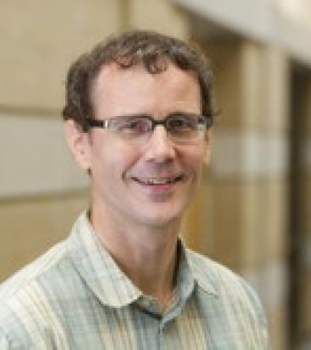
The Universal benefits of Mission
Woodberry, Robert D 2012
“The Missionary Roots of Liberal Democracy.” American Political Science Review 106(2): 244-274
Distinguished Article Award, Association for the Sociology of Religion, 2014. -
Best Article Award, Global and Transnational Sociology, 2014, American Sociological Association. -
Luebbert Award for Best Article in Comparative Politics, 2013, American Political Science Association. -
Best Article in Comparative Democratization, 2013, American Political Science Association. -
Distinguished Article Award, 2013. Sociology of Religion Section, American Sociological Association. -
Wallerstein Award for Best Published Article in Political Economy. 2013. American Political Science Association
–
Runner up. -
Best Paper on Comparative Democratization. 2011. American Political Science Association. -
More APSA and ASA outstanding article awards than any article in history.

Slide 21
“Social scientists tend to ignore religion in the process of post-Enlightenment modernization” p.244
“[…] demonstrating statistically that the historic prevalence of Protestant missionaries strongly predicts democracy in 142 non-European societies[…]” p.245
“What we consider modernity was not the inevitable result of economic development, urbanization, industrialization, secularization or the Enlightenment, but a far more contingent process profoundly shaped by activist religion”p.270

Slide 22
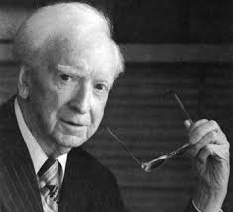
THE NEED FOR THE GOSPEL
“We talk of the second coming; half the world has never heard of the first”.
- Oswald J. Smith

Slide 23
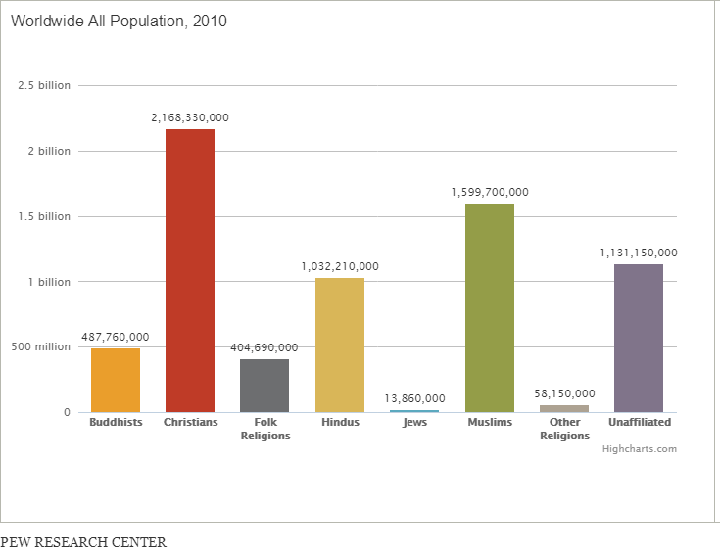

Slide 24
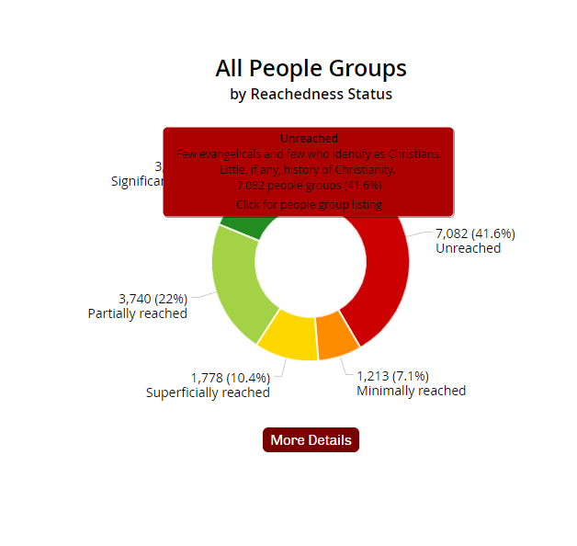

Slide 25
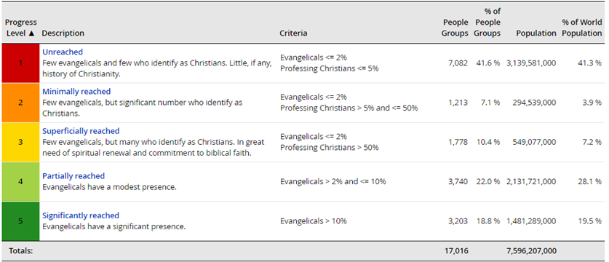

Slide 26
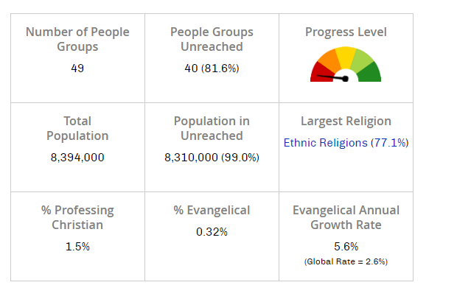
“[…]the Israeli Tourism Ministry said a record 3.6 million visitors came to the country last year, earning the nation $5.8 billion worth of revenue. The new record was an increase of 700,000 tourists over 2016”.
Source: https://www.travelpulse.com/news/destinations/israel-tourism-numbers-hit-record-high.html

Slide 27
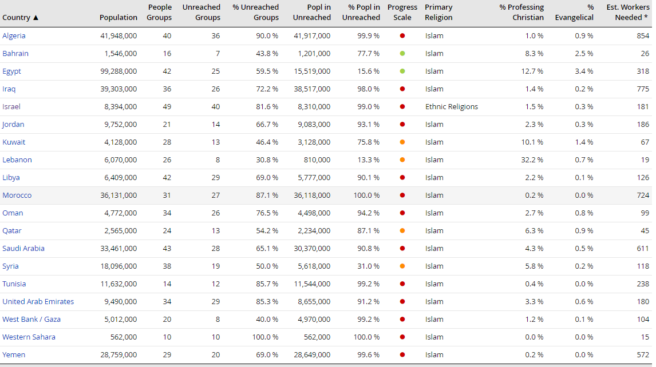

Slide 28
If you declare with your mouth, “Jesus is Lord,” and believe in your heart that God raised him from the dead, you will be saved.
Romans 10:9
Jesus answered, “I am the way and the truth and the life. No one comes to the Father except through me. If you really know me, you will know my Father as well. From now on, you do know him and have seen him.”
John 14:6-7

Slide 29
Summary
The objections to the Great Commission
The commission for the present
The not so great commission
A great commission, but not from Jesus
Why Mission?
The general benefits
The Gospel’s availability
The inclusive, but exclusive way to God

Slide 30


